Slide 1


The UN and international human rights and humanitarian law promotion
Funded by the European Union. Views and opinions expressed are however those of the author(s) only and do not necessarily reflect those of the European Union or the European Education and Culture Executive Agency (EACEA). Neither the European Union nor the granting authority can be held responsible for them.

Slide 2
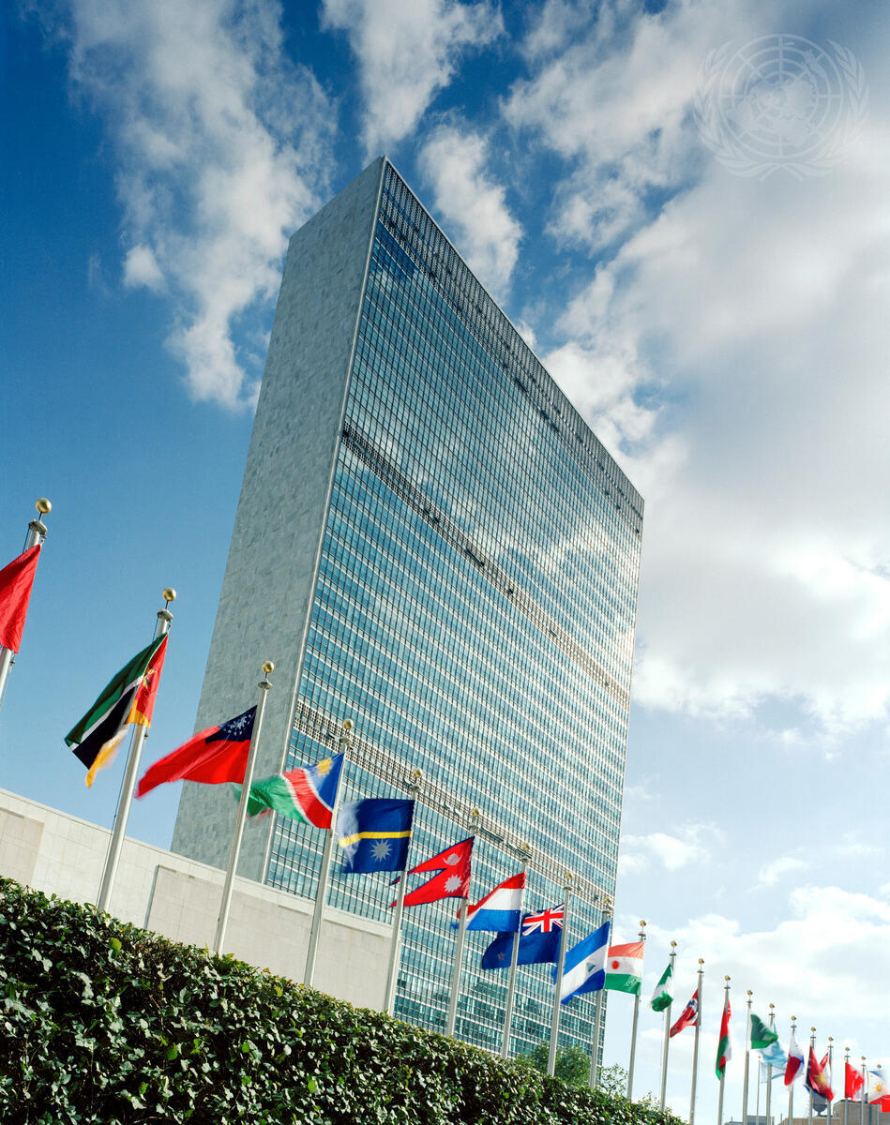
definitions
International human rights law (IHRL)
The body of international legal rules (mostly treaty-based and customary ones) conferring rights on individuals vis-à-vis States.
International humanitarian law (IHL)
The body of international legal rules (mostly treaty-based and customary ones) which seeks to limit the effects of armed conflict by (i) protecting persons who are not, or are no longer, participating in hostilities, and (ii) regulate the conduct of hostilities.
The United Nations Organization (UN)
Member States: 193
Main organs/bodies:
General Assembly
Security Council
Economic and Social Council
Trusteeship Council
International Court of Justice
Secretariat
Credit: UN Photo/Andrea Brizzi

Slide 3
IHRL in the UN charter (1)
Preamble
We the Peoples of the United Nations determined […] to reaffirm faith in fundamental human rights, in the dignity and worth of the human person, in the equal rights of men and women […].
Art. 1
The Purposes of the United Nations are: […].
3. To achieve international co-operation in solving international problems of an economic, social, cultural, or humanitarian character, and in promoting and encouraging respect for human rights and for fundamental freedoms for all without distinction as to race, sex, language, or religion.
Art. 55
With a view to the creation of conditions of stability and well-being which are necessary for peaceful and friendly relations among nations […], the United Nations shall promote: […] c. universal respect for, and observance of, human rights and fundamental freedoms for all without distinction as to race, sex, language, or religion.
Art. 56
All Members pledge themselves to take joint and separate action in co-operation with the Organization for the achievement of the purposes set forth in Article 55.
HOWEVER
DYNAMIC NATURE OF THE CHARTER
[see next slide]

Slide 4
IHRL in the UN charter (2)
UN practice
I. Shift in UN approach to human rights.
See, e.g., UNGA Res. 65/281 (2011): ‘[P]eace and security, development and human rights are the pillars of the UN system and the foundations for collective security and well-being’.
II. Institutions dealing with HRs
ECOSOC & Human Rights Commission → UNGA & Human Rights Council [see next slide].
UN GA (esp. third committee), UN SC, ICJ, …
Office of the High Commissioner for Human Rights (OHCHR).
The Un and international human rights and humanitarian law promotion

Slide 5
IHRL in the UN charter (3)
The Human Rights Council (1)
Membership
UN GA Res. 60/251 ‘Human Rights Council’ (15 March 2006):
7. Decides further that the Council shall consist of forty-seven Member States, which shall be elected directly and individually by secret ballot by the majority of the members of the General Assembly;
the membership shall be based on equitable geographical distribution, and seats shall be distributed as follows among regional groups: Group of African States, 13; Group of Asian States, 13; Group of Eastern European States, 6; Group of Latin American and Caribbean States, 8; and Group of Western European and other States, 7;
the members of the Council shall serve for a period of three years and shall not be eligible for immediate re-election after two consecutive terms;
8. Decides that the membership in the Council shall be open to all States Members of the United Nations;
when electing members of the Council, Member States shall take into account the contribution of candidates to the promotion and protection of human rights and their voluntary pledges and commitments made thereto;
the General Assembly, by a two-thirds majority of the members present and voting, may suspend the rights of membership in the Council of a member of the Council that commits gross and systematic violations of human rights;
9. Decides also that members elected to the Council shall uphold the highest standards in the promotion and protection of human rights, shall fully cooperate with the Council and be reviewed under the universal periodic review mechanism during their term of membership;
[…]
The Un and international human rights and humanitarian law promotion

Slide 6
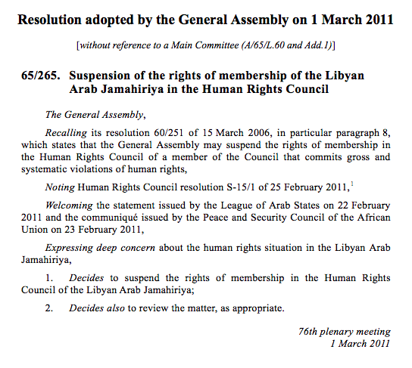
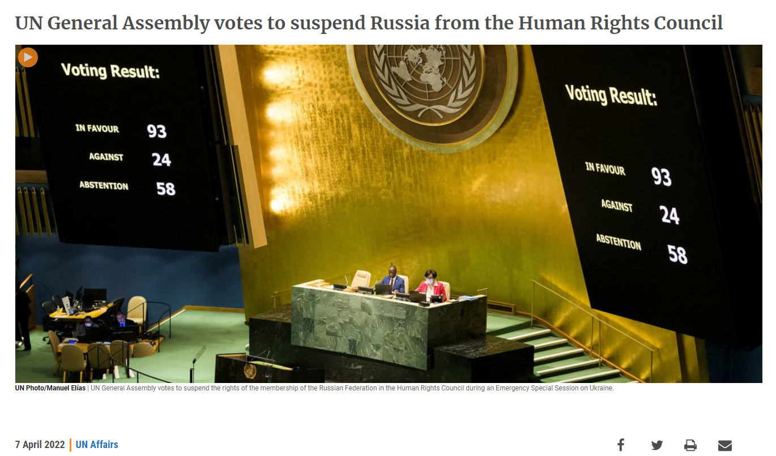
IHRL in the UN charter (4)
The Human Rights Council (2)
Membership
The Un and international human rights and humanitarian law promotion
EXAMPLES OF SUSPENSION
A/RES/ES-11/3 (8 April 2022); https://news.un.org/en/story/2022/04/1115782

Slide 7
IHRL in the UN charter (5)
The Human Rights Council (2)
Membership
https://www.ohchr.org/en/hr-bodies/hrc/members-by-group
AFRICAN STATES (13) | LATIN AMERICAN & CARIBBEAN STATES (8)
ASIA-PACIFIC STATES (13) | WESTERN EUROPE & OTHER STATES (7)
EASTERN EUROPEAN STATES (6)
Criticism:
See, e.g., European Parliament resolution of 13 March 2014 on EU priorities for the 25th session of the UN Human Rights Council (2014/2612(RSP)), parr. 2-5; https://www.amnestyusa.org/press-releases/u-s-withdrawal-from-un-human-rights-council-is-performative-disregard-for-human-rights/.

Slide 8
IHRL in the UN charter (7)
The Human Rights Council (2)
Functions (1)
UN GA Res. 60/251 ‘Human Rights Council’ (15 March 2006):
[The General Assembly]
…
1. Decides to establish the Human Rights Council, based in Geneva, in replacement of the Commission on Human Rights, as a subsidiary organ of the General Assembly; the Assembly shall review the status of the Council within five years;
2. Decides that the Council shall be responsible for promoting universal respect for the protection of all human rights and fundamental freedoms for all, without distinction of any kind and in a fair and equal manner;
3. Decides also that the Council should address situations of violations of human rights, including gross and systematic violations, and make recommendations thereon. It should also promote the effective coordination and the mainstreaming of human rights within the United Nations system;
…

Slide 9
IHRL in the UN charter (8)
The Human Rights Council (2)
Functions (2)
UN GA Res. 60/251 ‘Human Rights Council’ (15 March 2006):
[The General Assembly]
…
5. Decides that the Council shall, inter alia:
(a) Promote human rights education and learning as well as advisory services, technical assistance and capacity-building, to be provided in consultation with and with the consent of Member States concerned;
(b) Serve as a forum for dialogue on thematic issues on all human rights;
(c) Make recommendations to the General Assembly for the further development of international law in the field of human rights;
(d) Promote the full implementation of human rights obligations undertaken by States and follow-up to the goals and commitments related to the promotion and protection of human rights emanating from United Nations conferences and summits; …
(h) Work in close cooperation in the field of human rights with Governments, regional organizations, national human rights institutions and civil society;
(i) Make recommendations with regard to the promotion and protection of human rights; …

Slide 10
The UN and IHL promotion
UN Charter?
Practice:
‘Reaffirmation and progressive codification of international humanitarian law (standard-setting)
Ensuring prosecution and punishment of persons who have committed serious violations of that law
Increasing respect on the part of parties to specific conflicts for their obligations under international humanitarian law (humanitarian diplomacy)’*
* See H.-P- Gasser, The United Nations and International Humanitarian Law: The International Committee of the Red Cross and the United Nations' involvement in the implementation of international humanitarian law, International Symposium on the occasion of the fiftieth anniversary of the United Nations, Geneva, 19-21 October 1995 (available at: www.icrc.org/en/doc/resources/documents/misc/57jmuk.htm)
X
The Un and international human rights and humanitarian law promotion
‘The United Nations has taken a leading role in efforts to advance international humanitarian law. The Security Council has become increasingly involved in protecting civilians in armed conflict, promoting human rights and protecting children in wars.’ – https://www.un.org/en/global-issues/international-law-and-justice

Slide 11
References and suggested readings
UN official website
Bantekas and Oette, International Human Rights Law and Practice, CUP, 2024
Conforti and Focarelli, Le Nazioni Unite, CEDAM, 2020
H.-P- Gasser, ‘The United Nations and International Humanitarian Law: The International Committee of the Red Cross and the United Nations’ involvement in the implementation of international humanitarian law’, International Symposium on the occasion of the fiftieth anniversary of the United Nations, Geneva, 19-21 October 1995

Slide 12

Questions?
Please contact: …
12

Slide 13
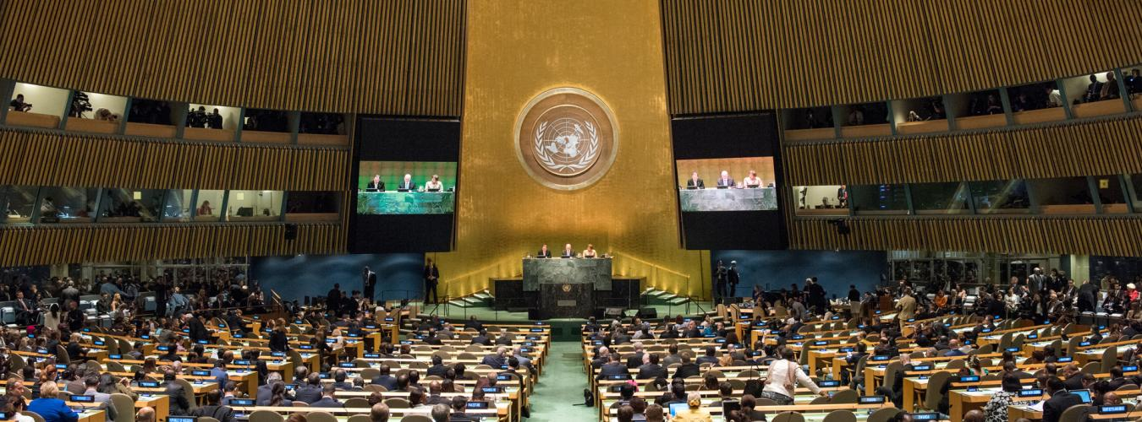
Zoom-in (1)
The UN General Assembly
Credit: UN Photo/Cia Pak
How many members?
Functions?
Voting procedure?
[Back]

Slide 14
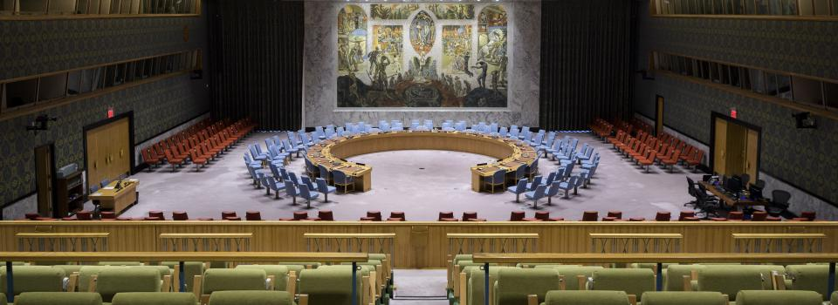
Zoom-in (2)
The UN Security Council
www.un.org
How many members?
Functions?
Voting procedure?
[Back]

Slide 15
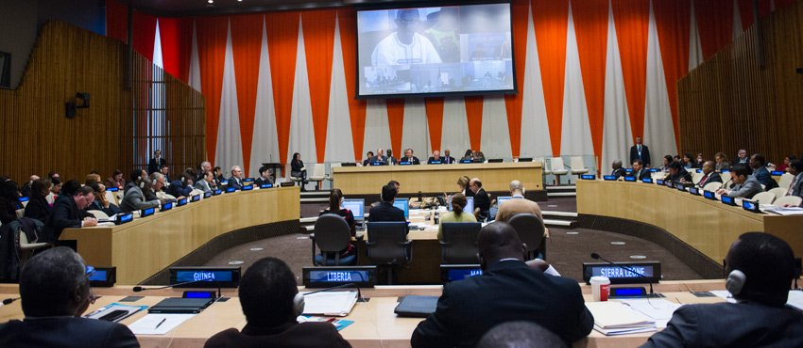
Zoom-in (3)
The UN Economic and Social Council
Credit: UN Photo/Amanda Voisard
How many members?
Functions?
[Back]

Slide 16
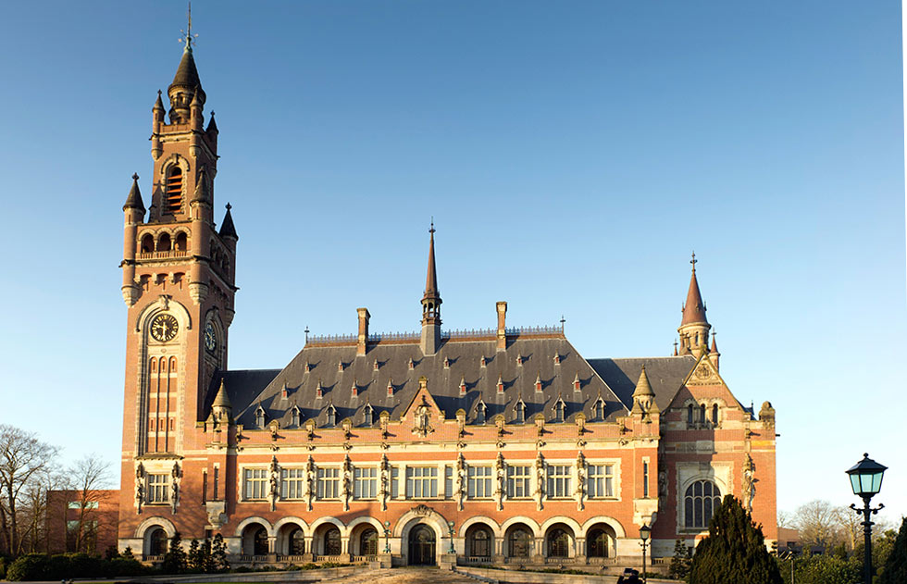
Zoom-in (4)
The International Court of Justice
Credit: …
www.un.org
Members?
Functions?
[Back]

Slide 17
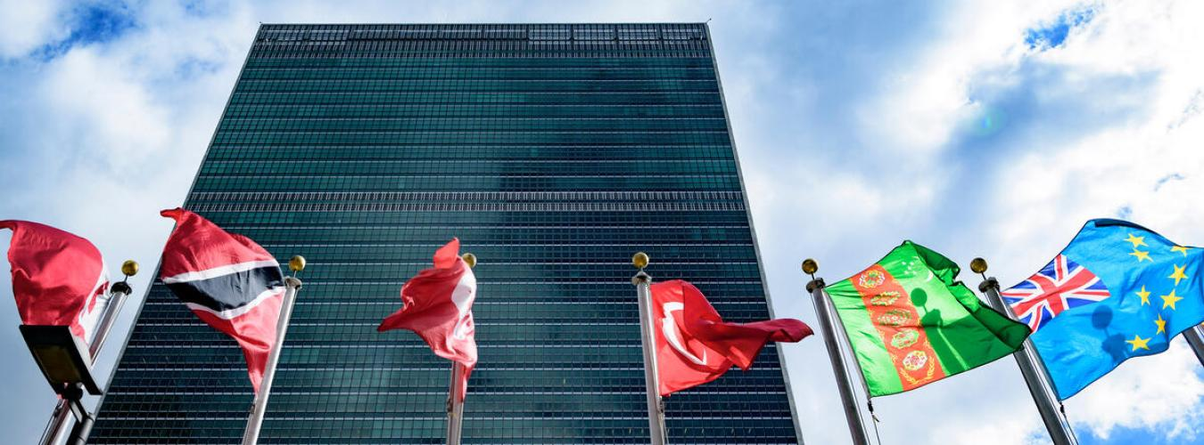
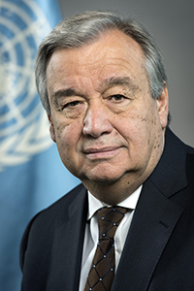
Zoom-in (5)
The UN Secretariat
United Nations Secretary-General, António Guterres
UN Photo/Mark Garten
Functions?
[Back]

Slide 18

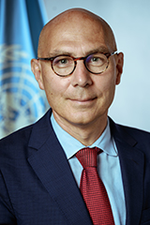
Zoom-in (6)
The Office of the High Commissioner for Human Rights
‘We represent the world's commitment to the promotion and protection of the full range of human rights and freedoms set out in the Universal Declaration of Human Rights’ – www.ohchr.org
Mandate of the High Commissioner and the Office:
Promote and protect all human rights.
Help empower people.
Assist Governments.
Inject a human rights perspective into all UN programmes.
See UN GA Res. resolution 48/141 of 1993.
Volker Türk
[Back]

Slide 19
Zoom-in (7)
European Parliament resolution of 13 March 2014 on EU priorities for the 25th session of the UN Human Rights Council (2014/2612(RSP))
The European Parliament,
…
2. Reiterates its belief that elections to the UNHRC need to be competitive, and expresses its opposition to the arranging of uncontested elections by regional groups; reiterates the importance of standards for UNHRC membership as regards commitment and performance in the human rights field, and urges the Member States to insist on such standards when defining the candidates they will vote for; emphasises that UNHRC members are required to uphold the highest standards in the promotion and protection of human rights; reiterates the importance of strong and transparent criteria for reinstating suspended members;
3. Expresses its concern about human rights abuses in a number of newly elected members of the UNHRC, including Algeria, China, Cuba, Morocco, Russia, Saudi Arabia and Vietnam;
…
[next slide]

Slide 20
Zoom-in (8)
European Parliament resolution of 13 March 2014 on EU priorities for the 25th session of the UN Human Rights Council (2014/2612(RSP))
…
4. Notes that Kazakhstan is currently one of the 47 members of the HRC; points out that the human rights situation in that country has deteriorated further since the brutal police repression of peaceful demonstrators and oil workers, their families and supporters in Zhanaozen on 16 December 2011, which, according to official figures, left 15 people dead and over 100 injured; calls on the HRC to implement without delay the call made by the High Commissioner for Human Rights, Navi Pillay, for an independent international investigation into the killing of oil workers in Kazakhstan; calls on Kazakhstan, as a member of the HRC, to guarantee human rights, repeal Article 164 of its penal code on ‘inciting social discord’, end the repression of, and lift the administrative obstacles placed in the way of, independent media, release political prisoners […] and drop all requests for the extradition of opposition politicians;
5. Continues to oppose ‘bloc voting’ in the UNHRC; urges the countries that are members of the UNHRC to remain transparent in their voting;
[Back]

