Slide 1


Legal framework on the EU administrative avenues for civil society’s participation
Funded by the European Union. Views and opinions expressed are however those of the author(s) only and do not necessarily reflect those of the European Union or the European Education and Culture Executive Agency (EACEA). Neither the European Union, nor the granting authority, nor Trilateral Research Ltd can be held responsible for them.

Slide 2
Introduction

Slide 3
Civil society participation: advocacy and lobbying
Advocacy work sits at the intersection of the broader categories of public affairs, public policy, and impact generation.
It refers to the communication, interaction, and influencing activities between an organisation and the public, government, and other stakeholders. It is the process of promoting or defending a cause, policy, or idea.
In social impact organisations, advocacy helps advance the organisation's mission by influencing public policy, mobilizing support, and raising awareness.
Advocacy can take many forms, including lobbying, public campaigns, and coalition building.
In social impact organisations, public affairs play a crucial role in:
Advocating for the organisation's mission;
Creating a synergistic regulatory environment;
Building reputation; and
Fostering community building.
Advocacy
Lobbying

Slide 4
Typical advocacy vs lobbying categorisation
Advocacy
Sharing good practices, success stories, model legislation
Lobbying
Attempting to influence specific legislation
Making available nonpartisan analysis, study or research
Discussing broad, social, economic and similar problems
Updating an organisation’s members on the status of legislation, without a call to action
Providing technical assistance or public advice to legislative body in response to a written request (e.g., hearings)
Coalition building
Providing comments or research on administrative/agency rules or regulations
Advocating for the adoption or rejection of a piece of legislation
Writing lobbying materials that support a position or specific recommendation
Contacting legislative staff in support or opposition to specific legislation (i.e., direct lobbying)
Urging the public to contact legislative staff in support or opposition to specific legislation (i.e., grassroots lobbying)
Strategy or coalition meetings that coordinate lobbying activities about specific legislation
Human rights advocacy often involves both aspects

Slide 5
Openness and transparency in EU law

Slide 6
Openness in EU law
Art 15(1) TFEU:
In order to promote good governance and ensure the participation of civil society, the Union institutions, bodies, offices and agencies shall conduct their work as openly as possible.
  In order to promote good governance…
  … and ensure the participation of civil society…
  …shall…
  Legitimacy driven (as confirmed in Interporc v Commission (C-41/00 P)

Slide 7
Transparency in EU law
Art 15(3) TFEU:
Any citizen of the Union, and any natural or legal person residing or having its registered office in a Member State, shall have a right of access to documents of the Union institutions, bodies, offices and agencies, whatever their medium, subject to the principles and the conditions to be defined in accordance with this paragraph.
  General principles and limits on grounds of public or private interest governing this right of access to documents shall be determined by the European Parliament and the Council, by means of regulations, acting in accordance with the ordinary legislative procedure.
  Each institution, body, office or agency shall ensure that its proceedings are transparent and shall elaborate in its own Rules of Procedure specific provisions regarding access to its documents (…).
  …
  The European Parliament and the Council shall ensure publication of the documents relating to the legislative procedures (…).
  Transparency and accountability-driven.

Slide 8
Nature of the two rules
Art 15(1) TFEU
A codified set of objectives to promote an aspirational goal
Art 15(3) TFEU
A substantive (and procedural) right of individuals

Slide 9
Transparency in action
EU institutions must exercise an active transparency:
Manifest intention to kick off a legislative initiative
Make information public during the process
  Not only drafts, but preparatory documents, impact assessments, etc.
    (see Heinrich (C-345/06))
And monitor the implementation of rules and regulations after the proceeding is concluded
In the administration of the institution itself
…with some caveats

Slide 10
Participation – primary legislation
Article 10 TEU:
[…]
Every citizen shall have the right to participate in the democratic life of the Union. …
Article 11 TEU:
The institutions shall, by appropriate means, give citizens and representative associations the opportunity to make known and publicly exchange their views in all areas of Union action.
The institutions shall maintain an open, transparent and regular dialogue with representative associations and civil society.
The European Commission shall carry out broad consultations with parties concerned in order to ensure that the Union's actions are coherent and transparent.

Slide 11
Lobbying in the EU: European Interest Representation
European Interest Representation includes: “all activities carried out with the objective of influencing the policy formulation and decision-making processes of the European institutions” (EC communication of 21 March 2007 – SEC(2007) 360)
A codified way to interact with the EU institutions
A transparency mechanism for citizens
A transparent mechanism for interest groups
It recognises the advantages of lobbying that we mentioned before
It attempts to address some of the challenges

Slide 12
Advocacy and lobbying – existing avenues and instruments

Slide 13
Transparency register
A register of organisations who are interest representatives at the EU level with an objective of influencing legislation.
It is mandatory (since 2021 – Interinstitutional Agreement)
It includes a Code of Conduct
It is enforceable
Activities covered:
Organising or participating in meetings, conferences or events, as well as engaging in any similar contacts with Union institutions;
contributing to or participating in consultations, hearings or other similar initiatives;
organising communication campaigns, platforms, networks and grassroots initiatives;
preparing or commissioning policy and position papers, amendments, opinion polls and surveys, open letters and other communication or information material, and commissioning and carrying out research.

Slide 14
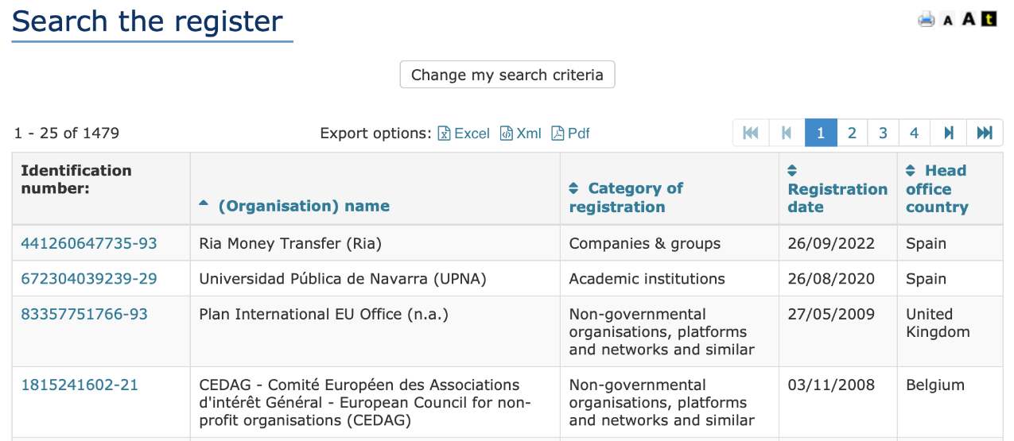
Transparency Register Examples
Link to the Transparency Register.

Slide 15
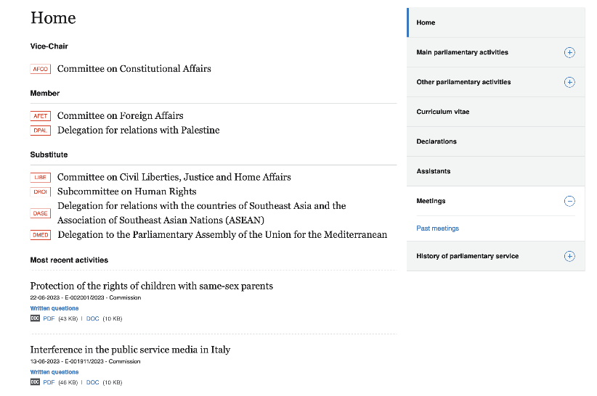
Transparency: MEPs meetings
MEPs must disclose meetings they hold or participate in involving interest groups. E.g.: Brando Benifei, a key player in the development of the EU Artificial Intelligence Act.

Slide 16
Exercise: search the register and the MEP database
Please search the register and the database:
On the register
  Look up an organisation you know
  Identify their lobbying or advocacy goals
  Make a small summary of the information you get
On the MEP database
  Look up a MEP that you have previously heard of or you know
  Identify their legislative priorities
  Check their meetings
  Make a small summary of the information you get.

Slide 17
Access to information and acts
The EU version of the so-called Freedom of Information principle. It takes the shape of a network of public databases and access to acts procedures.
EU-wide databases:
EUR-Lex
Transparency Register
DORIE
Each institution’s register of documents, e.g., EC Documents Register

Slide 18
Regulation (EC) No 1049/2001 (1)
Regulation (EC) No 1049/2001 of the European Parliament and of the Council of 30 May 2001 regarding public access to European parliament, council and commission documents
Scope:
Any citizen of the Union, and any natural or legal person residing or having its registered office in a Member State, has a right of access to documents of the institutions, subject to the principles, conditions and limits defined in [the] Regulation.
The institutions may, subject to the same principles, conditions and limits, grant access to documents to any natural or legal person not residing or not having its registered office in a Member State.

Slide 19
Regulation (EC) No 1049/2001 (2)
Exceptions:
The institutions shall refuse access to a document where disclosure would undermine the protection of:
the public interest as regards:
  public security,
  defence and military matters,
  international relations,
  the financial, monetary or economic policy of the Community or a Member State;
privacy and the integrity of the individual, in particular in accordance with Community legislation regarding the protection of personal data;
commercial interests of a natural or legal person, including intellectual property;
court proceedings and legal advice;
the purpose of inspections, investigations and audits.
Access to a document, …, which relates to a matter where the decision has not been taken by the institution, shall be refused if disclosure of the document would seriously undermine the institution's decision-making process, unless there is an overriding public interest in disclosure.

Slide 20
Regulation (EC) No 1049/2001 (3)
Exceptions:
Member State’s opposition (if the file originates from that MS)
Third-party documents
Classified documents (top secret, etc.; ”EU sensitive”)
How to apply:
In writing
Sufficiently precise question
Timeline: typically 15 working days (+15)
Cost: depending on size

Slide 21
Regulation (EC) No 1049/2001 (4)
Review process. Initiated in 2008… so far unsuccessful due to:
Narrow definition of what constitutes a ‘document’
  Legislative document vs administrative document
Narrow scope of application: agencies still not included (though they are not immune -> see TFEU)
Interesting developments:
Broader personal and geographical scope of application

Slide 22
Regulation (EC) No 1049/2001 (6)
Relevant case law:
T-424/14 and T-425/14 ClientEarth v Commission (Confirmed in Case C-612/18 – ClientEarth v Commission) – access to data ahead of a legislative procedure
‘This is all the more important in order to preserve the essence of the power of initiative conferred on the Commission by the Treaties and its capacity to assess, wholly independently, the appropriateness of a policy proposal. More specifically, it is important to protect that power of initiative from any influences exerted by public or private interests which would attempt, outside of organised consultations, to compel the Commission to adopt, amend or abandon a policy initiative and which would thus prolong or complicate the discussion taking place within that institution’ – (para 95).
Other relevant case law:
MyTravel (T-403/15 MyTravel v Commission)
So, you may encounter some limitation in the documentation you may access.

Slide 23
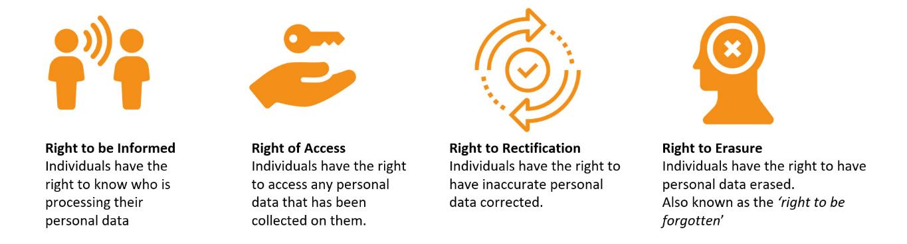
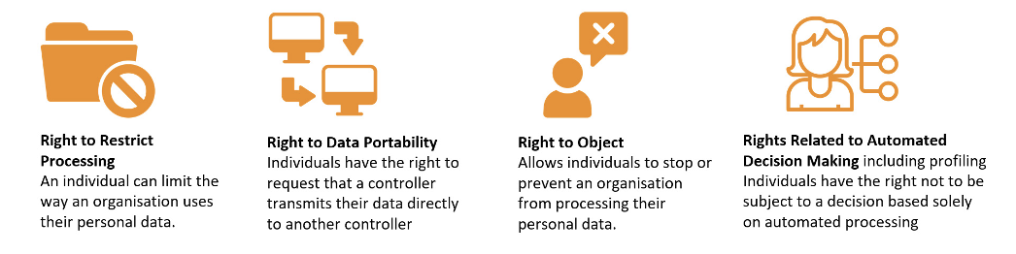
Access to Acts vs Data Protection right to Access (1)
Data Protection laws and regulations: Regulation (EU) 2016/679 (GDPR) and Regulation (EU) 2018/1725 (EUDPR)
Source: Databasix

Slide 24
Access to Acts vs Data Protection right to Access (2)
Subject Access right under GDPR – the right to obtain a copy of one’s personal data held by the data controller:
A copy of the data (no other information)
No third-party data
Can be limited
FOI – the access to document, instead of the personal data
Minutes, proposals, position papers, etc.
No personal data other than public figures
Can be limited

Slide 25

Questions?
Please contact: …
25

