Slide 1


International human rights advocacy to EU institutions in practice
Funded by the European Union. Views and opinions expressed are however those of the author(s) only and do not necessarily reflect those of the European Union, the University of Milan, or Trilateral Research Ltd. Neither the European Union, nor the granting authority, nor Trilateral Research Ltd can be held responsible for them.
Funded by the European Union. Views and opinions expressed are however those of the author(s) only and do not necessarily reflect those of the European Union or the European Education and Culture Executive Agency (EACEA). Neither the European Union, nor the granting authority, nor Trilateral Research Ltd can be held responsible for them.

Slide 2
The internal dimension

Slide 3
Advocacy and lobbying on EU lawmaking
There are two types of European interest representation:
  action taken by interest groups, associations and companies at the EU level
  action taken by interest groups, associations and companies at the national level, focusing on EU matters
Today, we will focus on the first one.

Slide 4
Narrow down the advocacy/lobby objective
The objective is key to understand how to conduct a successful campaign.
Advocacy objectives may be:
To raise awareness
To change a policy
To promote a new piece of legislation
Your organisation’s strategy and purpose will inform what actions you may consider based on the objective

Slide 5
Stakeholders
Identifying Key Stakeholders (the influencers):
Members of the European Parliament (e.g., from Committees)
Officials in the European Commission (e.g., in relevant DGs)
Council of the EU (working groups).
Other influencers
National politicians
Journalists
Industry leaders
(Associations, if you are not one!)
Use your network and research to identify who can influence decision-making.

Slide 6
Messaging
Advocacy and lobbying in the human rights context revolves around two possible avenues:
Increase awareness (i.e., they should know you)
Obtain a policy change (i.e., they should do something for/with you)
Messaging should be
Simple
Clear
Memorable
Emphasise the public benefit in the EU context and values.

Slide 7
Coalition building
One interest organisation alone is unlikely to have, on its own, a ground-breaking success in influencing human rights legislation. Therefore, it is essential to build groups and coalitions, with:
Organisations or individuals with similar objectives (e.g., privacy and transparency);
Organisations with a different, non-conflicting focus who have a larger audience and credibility;
Trade associations and other associations.

Slide 8
Exercise
Based on what we discussed today and in the previous lecture, pick a topic and identify:
An advocacy and, if applicable, lobbying objective
Required stakeholders
Messaging and milestones
Allies and challengers

Slide 9
Possible topics
Child protection – data sharing and systems integration
Disaster response and consequences on civilians
Emergency support for migrants
Other ideas?

Slide 10
The external dimension
IHRL

Slide 11
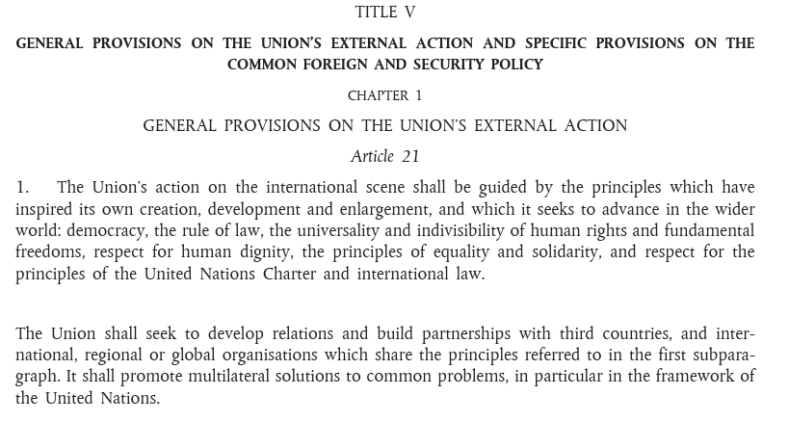
EU’s role in human rights advocacy
Two main streams of human rights policy and action within the European Union:
to protect fundamental human rights for EU citizens
to promote human rights, democracy and the rule of law worldwide

Slide 12



Key actors
External Action Service - Political and diplomatic engagement on behalf of the EU (e.g. sanctions) + High Representative Kaja Kallas
European Commission (DG INTPA - Neutral, impartial, needs-based aid – not political diplomacy) / DG ECHO (humanitarian)
EU Delegations (embassies abroad)
European Parliament
  Country delegations
  Special Committees and Subcommittees
  Interest Groups and Friendship Groups

Slide 13
Key instruments
Human Rights and Democracy Action Plan (HRDAP) 2020-2024 (extended until 2027)
EU Global Human Rights Sanctions Regime (“Magnitsky”)
Guidelines on Human Rights Dialogues (e.g., on human rights defenders)
EU Special Representative for Human Rights (currently Kajsa Ollongren, supports High rep Kaja Kallas)
Global Europe: Neighbourhood, Development and International Cooperation Instrument (until 2027)
Regulations (e.g., Corporate Due Diligence → Omnibus)
Motions for resolution (non-binding calls for action)

Slide 14
Advocacy actors
NGOs (e.g., Human Rights Watch, Amnesty International)
Submit reports and briefings to MEPs and EU officials, Lobby on resolutions, trade deals, sanctions, Run public campaigns and petitions, Engage EU Delegations abroad
Diaspora groups and Grassroots movements
Share testimonies with EU institutions, Organise protests and awareness campaigns, Partner with NGOs for advocacy, Contribute to sanctions and resolution efforts
Human rights lawyers
Submit legal analyses and opinions, Support strategic litigation within the EU, Help design legal frameworks (e.g., sanctions), Collaborate with courts and EU legal bodies
Activists
Academia
Testify at EU Parliament sessions, Participate in panels, hearings, and briefings, Seek asylum and raise protection concerns, Highlight repression through personal narratives
Publish studies and policy briefs, Advise on human rights tools and strategies, Host dialogues and training for EU staff

Slide 15
Advocacy in practice
Tools and tactics:
Submitting reports and briefings to EU institutions.
Lobbying Members of the European Parliament.
Participating in EU consultations.
Strategic media and public pressure.
Objectives:
Influence MEPs ahead of a key vote
Get the Commission to act
Swing Member States positions

Slide 16
Challenges and criticism
    Economic/political interests often outweigh human rights concerns.
    Fragmentation in EU Member States' positions.
    Lack of enforcement and rising restrictions on civil society.

Slide 17
Discussion
    Can the EU balance economic diplomacy and human rights?
Group work:
You are part of a NGOs representing a repressed group or minority. Prepare a short advocacy plan to influence the EU to act.
@AdvocUnimi

Slide 18
Learnings
EU decision-making (e.g. unanimity in foreign policy) can slow or block progress.
Focus on meaningful, high-level interactions over broad outreach.
Plan for delays! EU processes take time. Maintain sustained engagement.
Frame human rights in terms of current EU priorities (e.g. security, trade, migration).
Leverage coalitions and quick wins to build momentum and motivation.
Prioritise protection for partners, especially in high-risk contexts.

Slide 19
The external dimension
IHL

Slide 20
Advocacy Strategy
Goal
Power Analysis
Theory of Change
Messaging
Engagement
Adapt
Advocacy Exercise: Develop an advocacy strategy for an IHL issue

Slide 21

Setting your Goal
Problem tree:
What is the problem or issue you’re trying to address?
What are the effects and impact of that problem?
What is the root cause?
If you could fix one IHL or humanitarian problem, what would it be?

Slide 22
SMART objectives
Objectives
Objectives are small steps you can take towards achieving the larger goal. To know if you’re making progress towards your goal, you need to be able to track your objectives.
Specific
Measurable
Achievable
Relevant
Timebound

Slide 23
Power Analysis
Visible Power
Laws, military force, money
Invisible Power
norms, values, culture,
Hidden Power
Often illegitimate (e.g. corruption) important for blockers
What is the EU’s Power?
Who is the actor responsible for the humanitarian issue you’re trying to address? (Target)
Can you influence them directly?
  Is it safe? Who are you putting at Risk?
If you can’t influence them, who can? Who has power?
How do you engage their interest? (Leverage)

Slide 24
What power does the EU have?
Relevant provisions
TFEU:
Art 2 & 3 exclusive competence – all about money and the market.
Art 4.4 shared competence “In the areas of development cooperation and humanitarian aid, the Union shall have competence to carry out activities and conduct a common policy; however, the exercise of that competence shall not result in Member States being prevented from exercising theirs.
TEU:
Art 24: The common foreign and security policy … shall be defined and implemented by the European Council and the Council acting unanimously, except where the Treaties provide otherwise. The adoption of legislative acts shall be excluded. The common foreign and security policy shall be put into effect by the High Representative of the Union for Foreign Affairs and Security Policy and by Member States.

Slide 25
What interest does the EU have?
Common Foreign and Security Policy
Article 21 TEU: guides the Common Foreign and Security policy:
  (a) safeguard its values, fundamental interests, security, independence and integrity;
  (b) consolidate and support democracy, the rule of law, human rights and the principles of international law;
  (c) preserve peace, prevent conflicts and strengthen international security;
  (d) foster the sustainable economic, social and environmental development of developing countries, with the primary aim of eradicating poverty;
  …
  (g) assist populations, countries and regions confronting natural or man-made disasters; and
  (h) promote an international system based on stronger multilateral cooperation and good global governance.
Member States
Art 24:
It shall be defined and implemented by the European Council and the Council acting unanimously

Slide 26

Member States
Where to Influence in the EU?
Heads of State
European Council
External Action Service
Commission
Council of the EU
European
Parliament
MEPs
Ministers (FAC – PSC - COREPER)
Thematic working groups
Preparatory bodies (MAMA, COHAFA, COAFR, MOG, COEST, CONUN)
HR/VP
Kallas
Commissioners (ECHO, INTPA, NEAR)
EU Delegations in countries

Slide 27
The European Council
Consists of all Heads of State and Government of the EU member countries.
Political steering body representing the interests of Member States.
Responsible for establishing the EU’s common foreign and security policy – Tells the HR/VP what to do.
How do you influence Heads of State?

Slide 28
The Council of the EU
Consists of Ministers – which is why they call it the “Council of Ministers”
Legislative and budgetary functions
Advised by:
  Directors of the EEAS for that topic
  expert delegates from EU Member States
  Experts from the European Commission
Foreign Affairs Council (FAC)
Ministers of Foreign Affairs
The FAC adopts Council Conclusions after every meeting, setting policy guidelines

Slide 29
Council Preparatory Bodies (1)
Political and Security Committee (PSC)
Ambassadors from the 27 EU countries,
Acts under the responsibility of the HR/VP.
Monitors the international situation in the areas covered by the CFSP and plays a key role in defining and following up on the EU’s response to a crisis
Committee of Permanent Representatives (COREPER)
Does the preparatory work for the Committee
Permanent Representatives reside in Brussels
COREPER 2 – ‘Antici Group’
  economic and financial affairs
  foreign affairs
  general affairs
  justice and home affairs.
COREPER 1 – ‘Mertens Group’

Slide 30
Council Preparatory Bodies (2)
COHOM – Human Rights
CODEV – Development Cooperation
RELEX – Foreign Relations Counsellors
MAMA – Mashreq/Maghreb Working Party
COHAFA – Humanitarian Aid and Food Aid
ACP – African, Caribbean and Pacific
COAFR – Africa Working Party
MOG – Middle East and Gulf
COASI – Asia-Oceania Working Party
COEST – Eastern Europe and Central Asia
CONUN – United Nations Working Party
COTRA – Transatlantic Relations
CODEV-PI – Working Party on Development Cooperation and International Partnerships
COMET – Restrictive measures to combat terrorism
Terrorism (International Aspects)
External Aspects of Asylum and Migration
Working Party on Maritime Issues
Working Party on Non-Proliferation and Arms Exports
Working Party on Public International Law
And a whole lot more…
COMEP – Ad hoc Working Party on the Middle East Peace Process

Slide 31
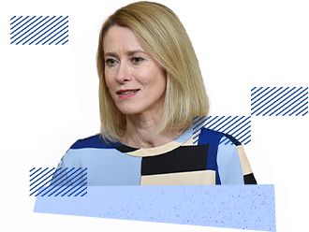
The HR/VP and the European External Action Service (EEAS) (1)
Article 27 TEU
  The High Representative of the Union for Foreign Affairs and Security Policy, who shall chair the Foreign Affairs Council, shall contribute through his proposals towards the preparation of the common foreign and security policy and shall ensure implementation of the decisions adopted by the European Council and the Council.
  The High Representative shall represent the Union for matters relating to the common foreign and security policy. He shall conduct political dialogue with third parties on the Union's behalf and shall express the Union's position in international organisations and at international conferences.
  In fulfilling his mandate, the High Representative shall be assisted by a European External Action Service.
Picture available at: https://www.consilium.europa.eu/en/council-eu/high-representative-foreign-affairs-security-policy/#kaja-kallas

Slide 32
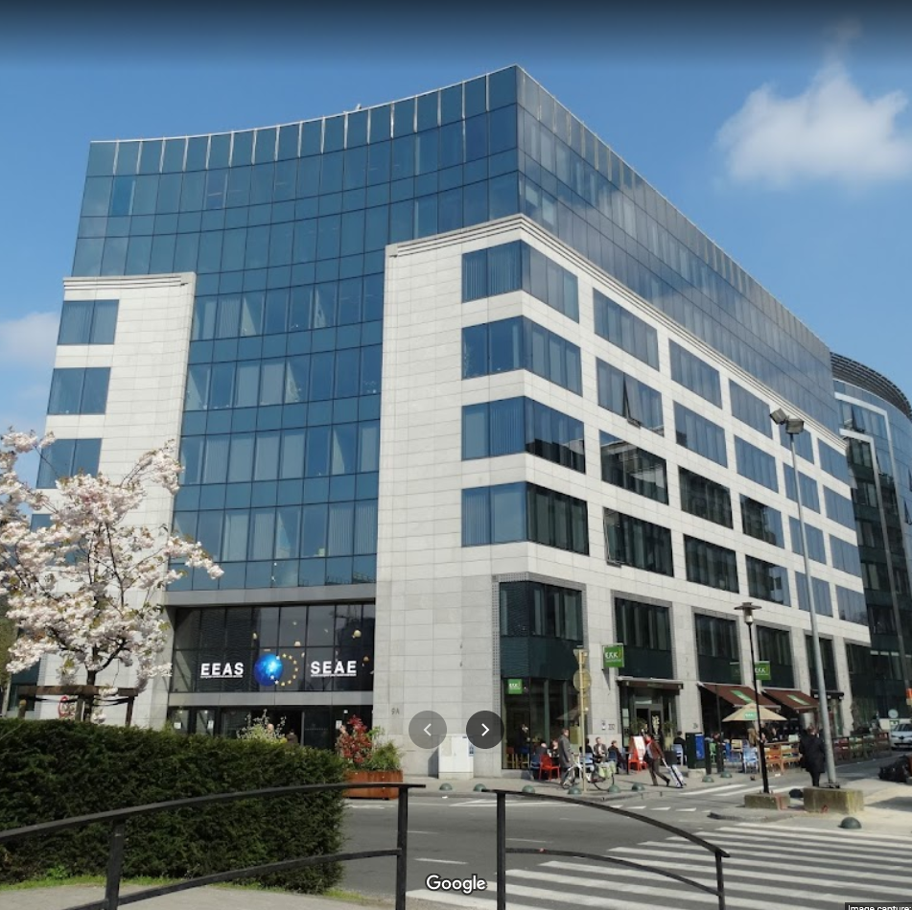
The HR/VP and the European External Action Service (EEAS) (2)
EEAS
Key target on most foreign affairs matters
Sits on most council preparatory bodies and prepares the FAC conclusions
Decision making power still sits with members, but EEAS can be highly persuasive
Has thematic and regional experts
Nearly 150 delegations based all over the world

Slide 33
The Commission (1)
Operates independently from Member States (but commissioners are still very political)
EU body with the right of initiative to make legislative proposals to the Council and the Parliament
Implements decisions and manages programs
Directorates General are implementing arms

Slide 34
DG ECHO
The Commission (2)
The Hum/Dev Nexus
DG INTPA
Directorate-General for Humanitarian Aid
Responsible for the design and implementation of EU humanitarian aid programs;
One of the largest humanitarian donors
Has an extensive country presence and regularly visits programs
Often hosted with the EEAS delegation
Directorate-General for International Partnerships (formerly DEVCO)
responsible for formulating the EU’s international partnership and development policy,
Aims to reduce poverty, ensure sustainable development, and promote democracy, human rights, and the rule of law
One of the largest development donors

Slide 35
EU Parliament
Has oversight of EEAS Budget
Has oversight of ECHO and INTPA budgets
Adopts legislation
Debates policy and legislation, often publicly
Has a clear constituency
Active in media and social media
Thematic working groups can draft resolutions, directives, etc
AFET - Committee on Foreign Affairs
DEVE: Committee on Development
DROI: Subcommittee on Human Rights
INTA: Committee on International Trade

Slide 36
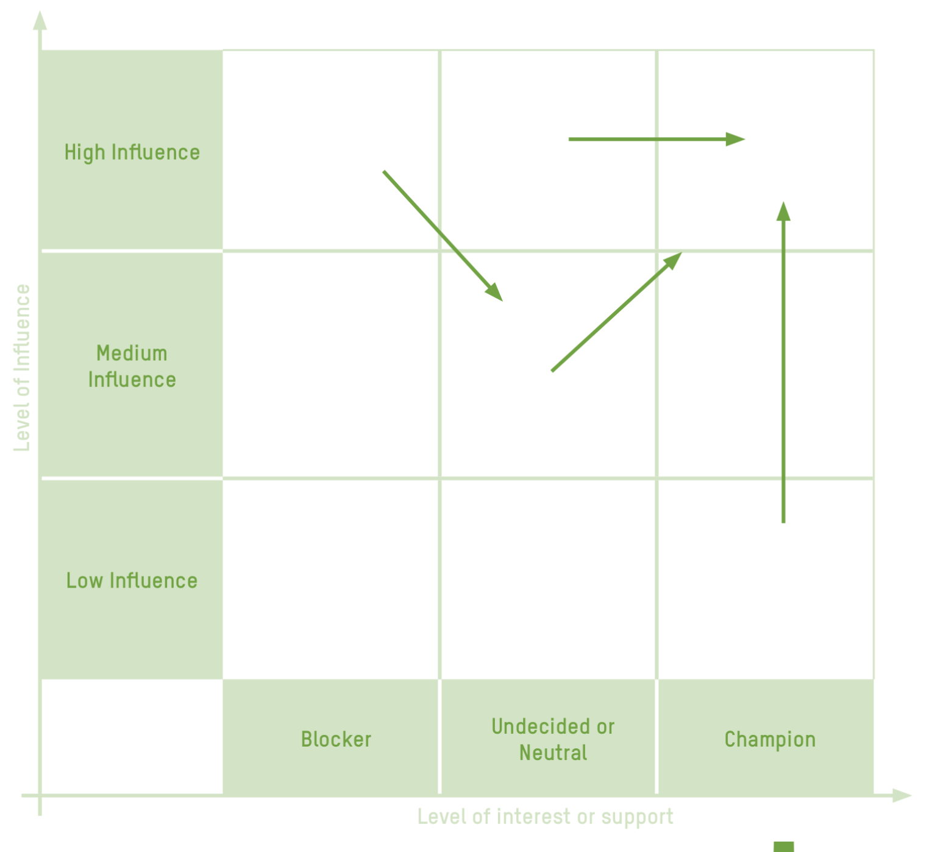
Power Mapping
Who in the EU has power to progress your goal?
Who are your allies/champions?
Who are the Blockers?

Slide 37
Theory of Change
How do you access the power holders?
What can encourage champions?
What can increase a champions influence?
What can decrease a blockers influence?
What are your assumptions?
What are the missing links?
TOC in the East Africa hunger crisis:
Women, girls, and men affected by a severe food insecurity will receive the assistance they need in accordance with their human rights:
if the national government and local NGOs effectively leads the response;
the UN and other humanitarian agencies effectively coordinate their activities; and
all wealthy countries contribute their fair share towards humanitarian appeals.
This will happen if:
the national government, UN and humanitarian agencies are held accountable for their performance by empowered communities, coordinated national civil society and donors;
if the public and citizens in wealthy countries are aware of and concerned about the crisis, and demand their governments provide their fair share of funding for appeals; and
Civil society works in alliance with relevant stakeholders, uses an effective mix of insider and outsider strategies to widen political space and influence government, and uses communications and media to raise awareness among the public.
Are there potentially unintended consequences?

Slide 38
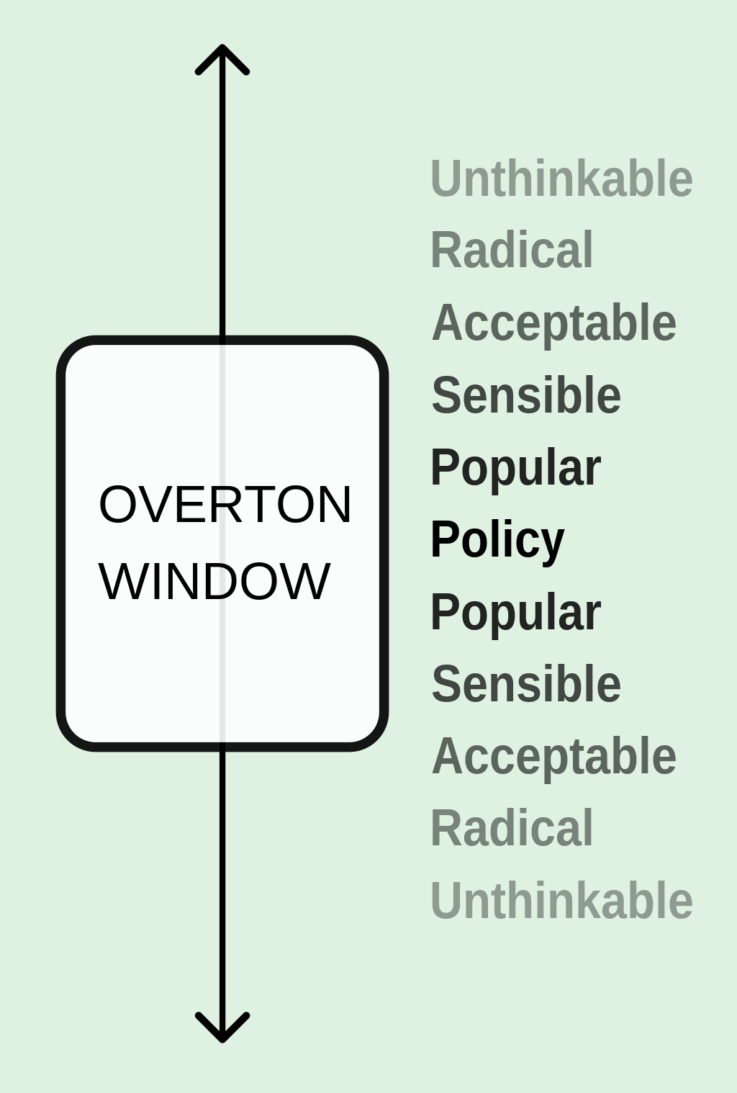
Messaging
Be within the window
Be specific, tailored and realistic with asks
What is your audience willing to hear?
Who will your audience listen to?
Within the window or not?
Source: https://en.wikipedia.org/wiki/Overton_window

Slide 39
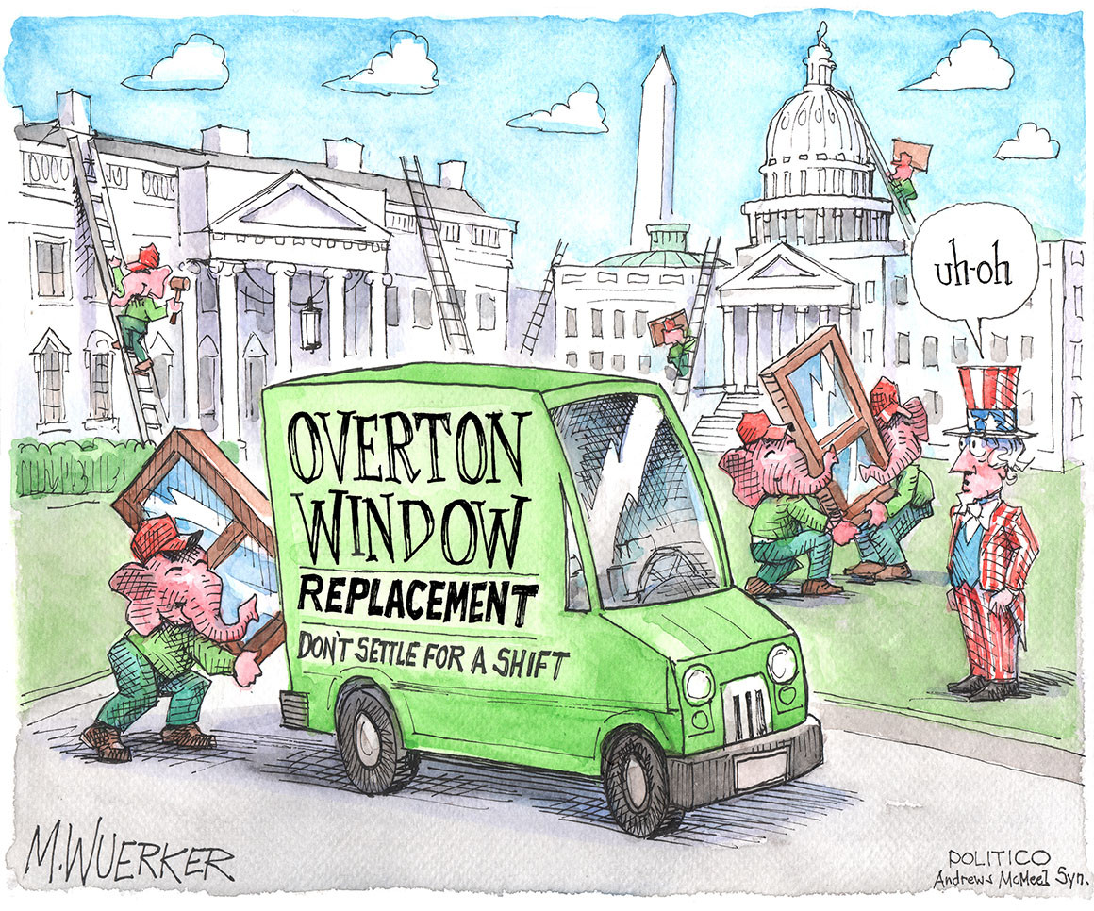
Or totally outside the window
Be bold and even outlandish in statements
Make the extraordinary seem possible

Slide 40
Tactics
Research and policy development
Supporting community engagement on issues
Lobbying and direct advocacy
Convening and facilitating alliances and network building
Mobilization and public campaigning
Communications and media
“Amateurs talk strategy, experts talk logistics” – Omar Bradley
What resources will you need?
How are you going to fund this?
Is your funding independent?
Is your funding sustainable?

Slide 41
Risk Analysis
Risk Rating = Severity x Likelihood
Threat | Severity | Likelihood | Risk Rating | Mitigation
Who is the counter lobby?
Who is associated with you?
Where are you getting your information from?
What is your legitimacy?
Notes:
Pride month example

Slide 42
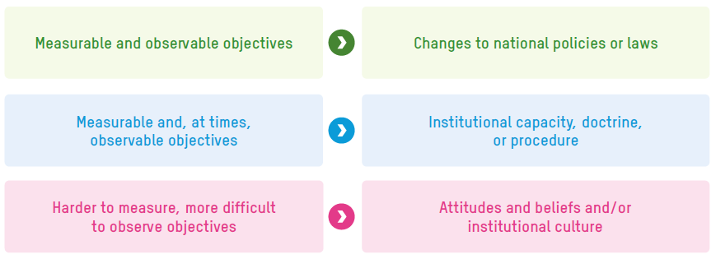
Monitor and Adapt
Your Theory of Change is based on assumptions which have to be regularly checked. Is it working? If not, why not?
Don’t be afraid to start fresh, but have patients to stick with long term strategies
The bigger your goal, the harder it is to measure

Slide 43
Advocacy Strategy
What was your goal?
What power does the EU have to address it?
Who would be your allies, and who would be the blockers?
What tactics would you use?
What are the risks?

Slide 44

Questions?
Please contact: …
44

