Slide 1


Avenues for participation in the UN human rights treaty system
Funded by the European Union. Views and opinions expressed are however those of the author(s) only and do not necessarily reflect those of the European Union or the European Education and Culture Executive Agency (EACEA). Neither the European Union nor the granting authority can be held responsible for them.

Slide 2
UN Human Rights treaty system
9 core HR treaties → 9 (+ 1) treaty bodies
International Convention on the Elimination of all forms of Racial Discrimination (1965-1969) → CERD
International Covenant on Civil and Political Rights (1966-1976) → HRCttee
International Covenant on Economic, Social and Cultural Rights (1966-1976) → CESCR
Convention on the Elimination of all forms of Discrimination against Women (1979-1981) → CEDAW
Convention against Torture and other cruel, inhuman or degrading treatment (1984-1987) → CAT
OPCAT (2002-2006) → SPT
Convention on the Rights of the Child (1989-1990) → CRC
International Convention on the Protection of the Rights of all Migrant Workers and Members of their Families (1990-2003) → CMW
Convention on the Rights of Persons with Disabilities (2006-2008) → CRPD
International Convention on the Protection of All Persons from Enforced Disappearance (2006-2010) → CED

Slide 3
Treaty bodies’ role
They monitor the implementation by State parties of the respective treaties.
While doing so, they provide authoritative interpretation of the treaties.
Tools:
State reporting
Presentation → exam (constructive dialogue) → concluding observations → follow-up
Quasi-judicial competences
Exam of individual (and State) communications → views/opinion (not legally binding)
Issuing General comments/General recommendations.
[SPT: special task of visiting detention sites in order to prevent torture and cruel, inhuman or degrading treatment]

Slide 4
NGOs’ role
Relevant treaty rules
In older treaties (e.g., ICCPR), NGOs are not considered in the text of the treaty.
There may be provisions in the Committee’s Rules of procedure.
E.g., HRCttee’s Rules of procedure (2021), Rule 96.1:
‘When considering communications under the Optional Protocol, the Committee or its special rapporteur may accept information and documentation submitted by third parties which may be relevant for the proper determination of the case.’
Convention on the Rights of the Child
Article 45(a):
‘The Committee may invite the specialized agencies, the United Nations Children's Fund and other competent bodies as it may consider appropriate to provide expert advice on the implementation of the Convention in areas falling within the scope of their respective mandates.’
Similarly, CRPD, Article 38(a).

Slide 5
NGOs’ role
Contribution (1)
To the drafting of the nine core HR treaties.
Esp. CRC, CRPD.
To treaty bodies’ activities:
States’ reporting:
Provide the Committee with alternative information
Influence the selection of the list of issues prior to reporting
Provide shadow/alternative reports
Influence questions asked during constructive dialogue (but no speaking right) and recommendations contained in concluding observations
Intervene in the follow-up phase
Brief Committee members (informal lunchtime briefing sessions; informal meetings with single Committee members)
…

Slide 6
NGOs’ role
Contribution (2)
To treaty bodies’ activities:
…
Individual communications:
NGO acts as representative of the petitioner (only form admitted by all committees); or
NGO submits communication on behalf of the victim, who is unable to bring the complaint and to give consent (NGO shall prove locus standi); or
NGO acts on its own behalf; or
NGO acts as amicus curiae.
General Comments:
E.g., International League for Human Rights in the drafting of CEDAW’s General Recommendation 19 on violence against women (1992).

Slide 7
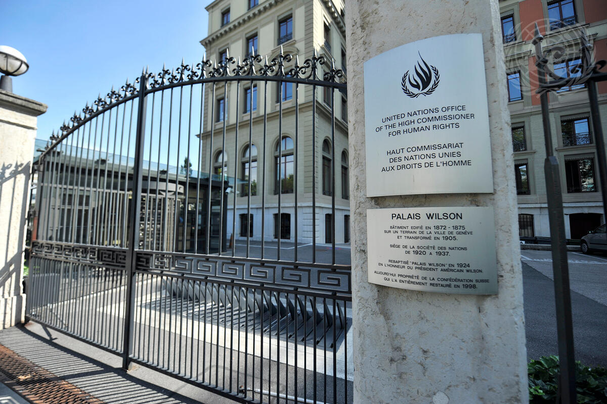
2025 Financial crisis
12 June 2025: CSOs’ joint call
‘Urgent support needed for the UN Treaty Bodies’
© UN Photo / Jean-Marc Ferré

Slide 8
References and suggested readings
Fiona McGaughey, Non-Governmental Organisations and the United Nations Human Rights System, Routledge, 2021
Katarzyna Sękowska-Kozłowska, «The Role of Non-governmental Organisations in Individual Communication Procedures before the UN Human Rights Treaty Bodies», Czech Yearbook of International Law, V-2014, pp. 367-388
Hinako Takata, «Dissecting Stakeholder Participation in UN Human Rights Treaty Body Activities with Normative and Empirical Approaches: A Comparison of NGO and NHRI Participation», German Law Journal, 25-2024, pp. 237-261
International Service for Human Rights, Guide for Third Party Intervention before UN Human Rights Treaty Bodies 2022
https://www.ohchr.org/en/treaty-bodies

Slide 9
NGO acting as amicus curiae
Example: Bujdosó v. Hungary, CRPD views of 9 September 2013 (see)
Autonomous intervention of Harvard Law School Project on Disability (HPOD), whose theses (exposed in the views) were adopted by the Committee

Slide 10

Questions?
Please contact: …
10

Slide 11
ZOOM-IN (1)
NGO as victim’s representative
It may be regulated in the rules of procedure
E.g., HRCttee’s Rules of procedure, Rule 91:
‘Communications may be submitted by or on behalf of one or several individuals, whose names should be provided. Where a communication is submitted on behalf of one or several individuals, this shall be with their consent, unless the author(s) can justify acting on their behalf without such consent.’
Example: Osmani v. Serbia, CAT decision of 25 May 2009
[Back]

Slide 12
ZOOM-IN (2)
NGO acting on behalf of victim
See: HRCttee’s Rules of procedure, Rule 91
Example: Goekce v. Austria, CEDAW views of 6 August 2007
Compare and cntrast with U.R. v. Uruguay, HRCttee inadmissibility decision of 6 April 1983
[Back]

Slide 13
ZOOM-IN (3)
NGO acting on its own behalf
ICCPR
Communications may be submitted by ‘individuals’ (groups of individuals admitted by HRCttee, but not NGOs)
CERD
Communications may be submitted by ‘individuals or groups of individuals’ (interpreted by CERD as including NGOs)
Example: Zentralrat v. Germany, CERD opinion of 22 February 2008
[Back]

Slide 14
ZOOM-IN (4)
NGO acting as amicus curiae
Amicus curiae brief = third party submission to a treaty body. Purpose: to provide a legal opinion (clarifying or developing legal reasoning on admissibility or on the merits); to provide additional information (on the context).
Only some committees have special rules for third party submissions.
E.g., HRCttee’s Rules of procedure, Rule 96:
1. When considering communications under the Optional Protocol, the Committee or its special rapporteur may accept information and documentation submitted by third parties which may be relevant for the proper determination of the case.
2. The Committee will establish guidelines for the requirements to be observed for third-party submissions.
3. The Committee shall forward third-party submissions to the parties to the communication, who are entitled to submit written observations and comments in reply.
4. Individuals or entities that are third parties shall not be considered parties to the communication.
Proper amicus curiae briefs are submitted autonomously, which is not possible before all committees.
Third parties’ submissions can however be provided also at the request either of a treaty body or a party to the case (→ ‘legal opinion’ / ‘expert submission’). Usually by specialist organisations, or authors with specific expertise.
Example: Bujdosó v. Hungary, CRPD views of 9 September 2013 (autonomous intervention of Harvard Law School Project on Disability (HPOD))
[Back]

